Slide 1


Advisor: DR. XIAO LIU SUSHRUTI ACHARYA GARGI JAGTAP SOWMYA PARLAPALLI ADESH VALECHA
P3 – DATA ANALYTICS PROJECT

Slide 2








WHO IS P3?
AEROSPACE
Consulting, application and implementation services for all major OEMs and their tier 1 suppliers
75% OF PEOPLE
are engineers
>45 LOCATIONS
in 12 countries and more than 3700 employees
AUTOMOTIVE
Consulting, management support and testing services for the automotive industry
TELECOMMUNICATIONS
Consulting, engineering and testing services for the whole telecommunications industry
>30 SUBSIDIARIES
in the whole P3 group
ENERGY & OTHER INDUSTRIES
Innovative solutions based on a scientific background for energy transition
REVENUE
>370 m euros

Slide 3
PROJECT SCOPE
To work in collaboration with P3 Communications to perform competitive and descriptive analysis on the data collected on smartphones

Slide 4

INSIGHTS NEEDED:
Density of a Wireless Network Assessment:
In which area carrier A has a strategic advantage above operator B due to denser presence (more capacity, better outdoor coverage)
Note: Operator names changed due to confidentiality agreement with P3

Slide 5
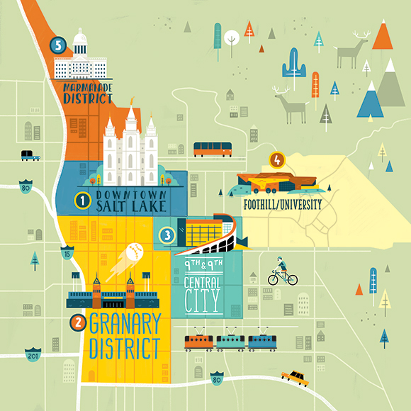
INSIGHTS NEEDED:
Density of different operators in Salt Lake City
Number of connections for each operator
Weekday vs weekend and holidays
Hour of the day

Slide 6
RX Level
LAC
MCC
MNC
DATA DICTIONARY
Radio EnodebID
GUID
NIRID
Screen State
Network Generation
Service State
Notes:
RX level tells you the signal strength. The values are usually negative and -90 is considered to be really good
LAC is the location area code. Its different than the area code we use on a day to day basis
MCC is the mobile country code. Each country will have its own country code
MNC is the mobile network code
LAC, MNC, MCC and EnobebID together makes a one unique cellsite
GUID is the phone ID in the apps
Network Generation is to know whether the network is 1G, 2G, 3G, 4G
Screenstate- When the screen is ON
NIRID- Its a record ID When a user updates the GPS, a use case is triggered
ServiceState- Whether the device signal is inservice, emergency only or out-of-service
Enodebid- its the hardware that is connected to the mobile phone network that communicates via antennas with the handsets
How this data is collected: P3 partners with apps and have SDK’s on those apps and whenever user open the app using their mobile data , P3 gets the track of these details.

Slide 7
FEASIBILITY ANALYSIS
Analyzed 6 days of sample data on PySpark
Worked on visualization on Tableau
Modeling cannot be performed due to no labeled variable in the data
Our solution - perform Exploratory Data Analysis

Slide 8






COMPUTATIONAL INFRASTRUCTURE
$1500 credit towards AWS

Slide 9
DATA PREPARATION
Variable Selection
4G On 
Screenstate On 
Servicestate On 
Null Values 
Dealing with millions of records:
94,133,251
Variable Selection
4G On
Screenstate On
Servicestate On
Null Values
No. Of Records:
44,552,748

Slide 10
DATA PREPARATION
Extracted time and hour from timestamp
Data for the years:
2017: December
2018: April, May, June, July & August

Slide 11



DATA ANALYSIS
Identifying patterns on holidays: Memorial Day, Independence Day and Pioneer Day
Network traffic for each cell site on each day
Analyzing peak vs low hour

Slide 12
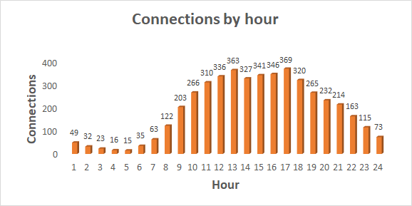
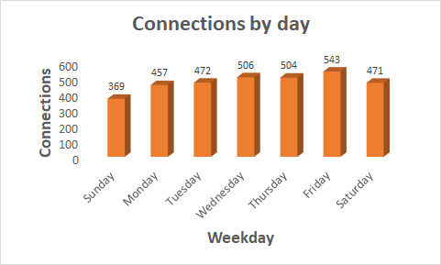
Average number of distinct users - Vodafone

Slide 13
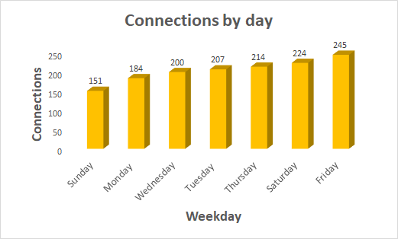
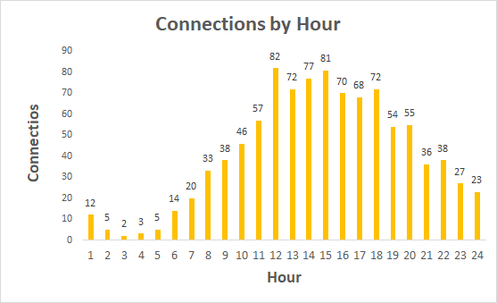
Average number of distinct users - Idea
Notes:
Friday and Saturday are leading
12Pm, 3pm we see a dip in the early hours (2am - 5am)

Slide 14
DATA ANALYSIS
Active users and new cell sites connected for different operators
Location with best and poor connections for each of the operator: IDEA, Vodafone, Airtel and Reliance
Analyzing network traffic on weekdays vs weekends

Slide 15
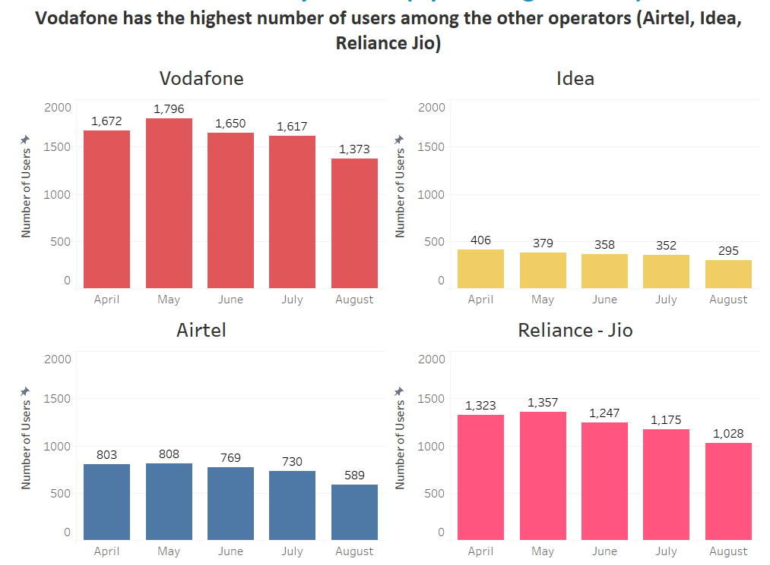
Active users reported in P3 cloud

Slide 16
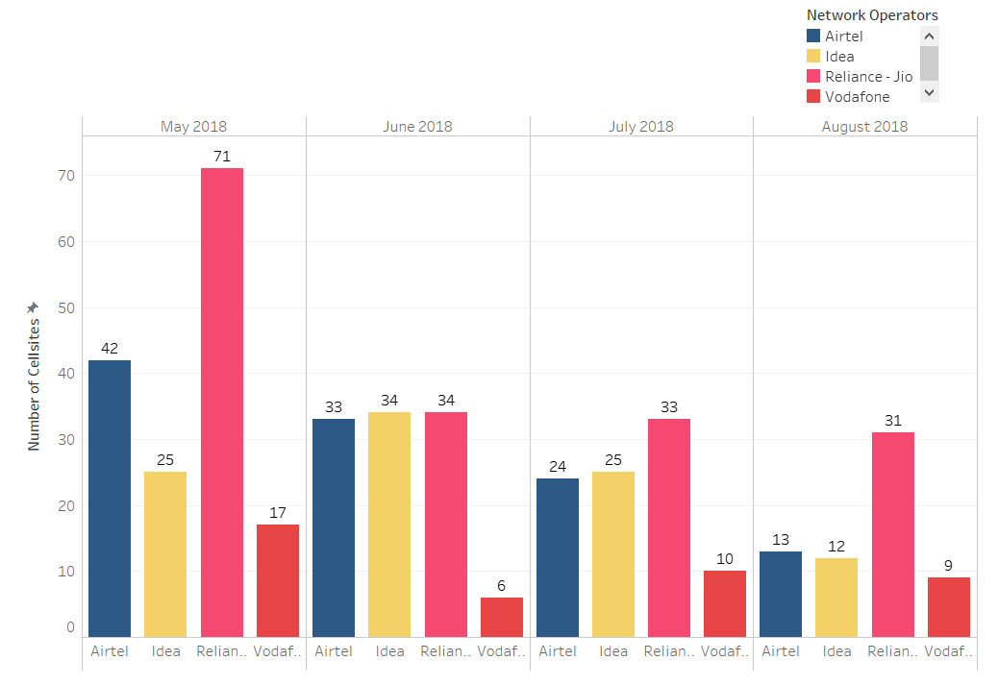
New cell sites connected by the users

Slide 17
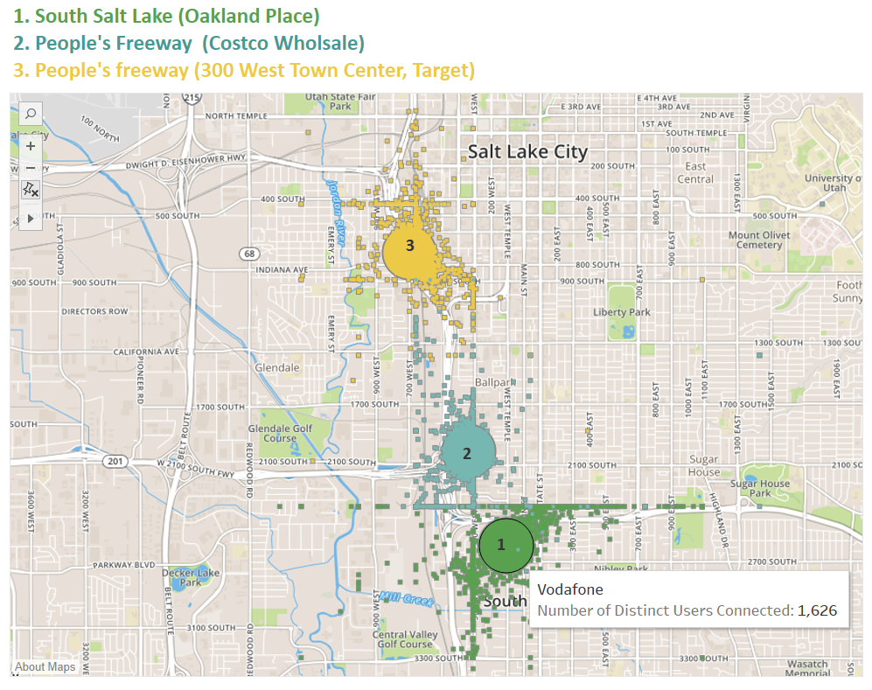
Top Sites by network usage for Vodafone

Slide 18
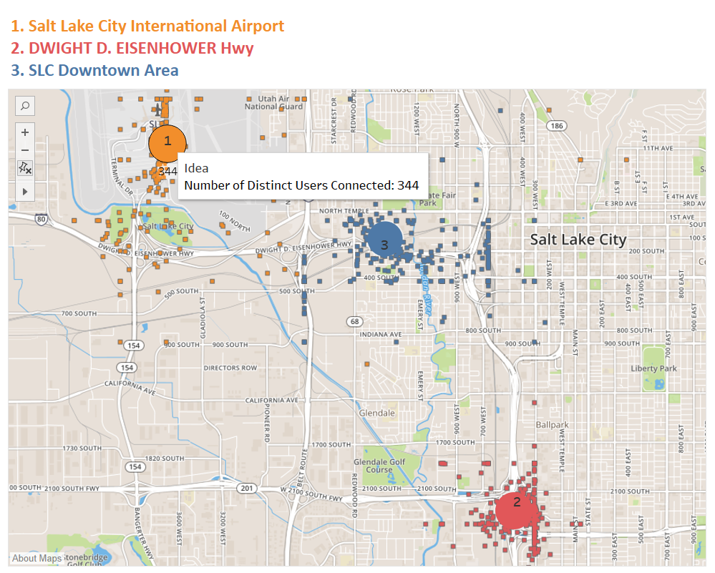
Top Sites by Network usage for Idea

Slide 19
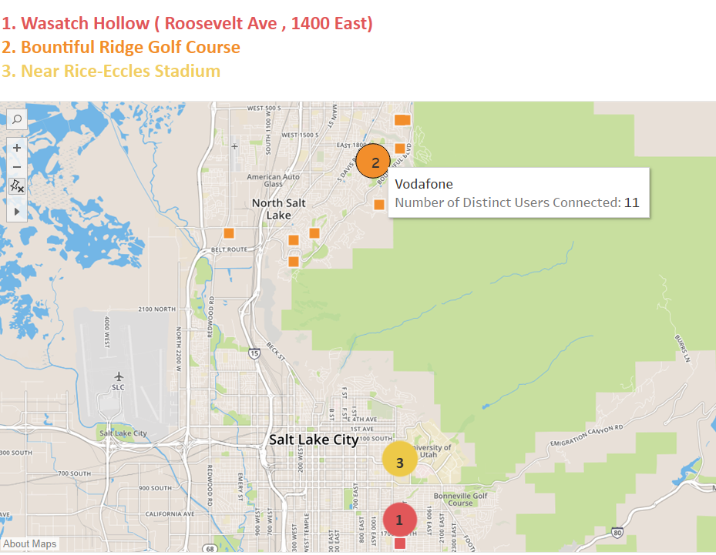
Sites with low network usage for Vodafone

Slide 20
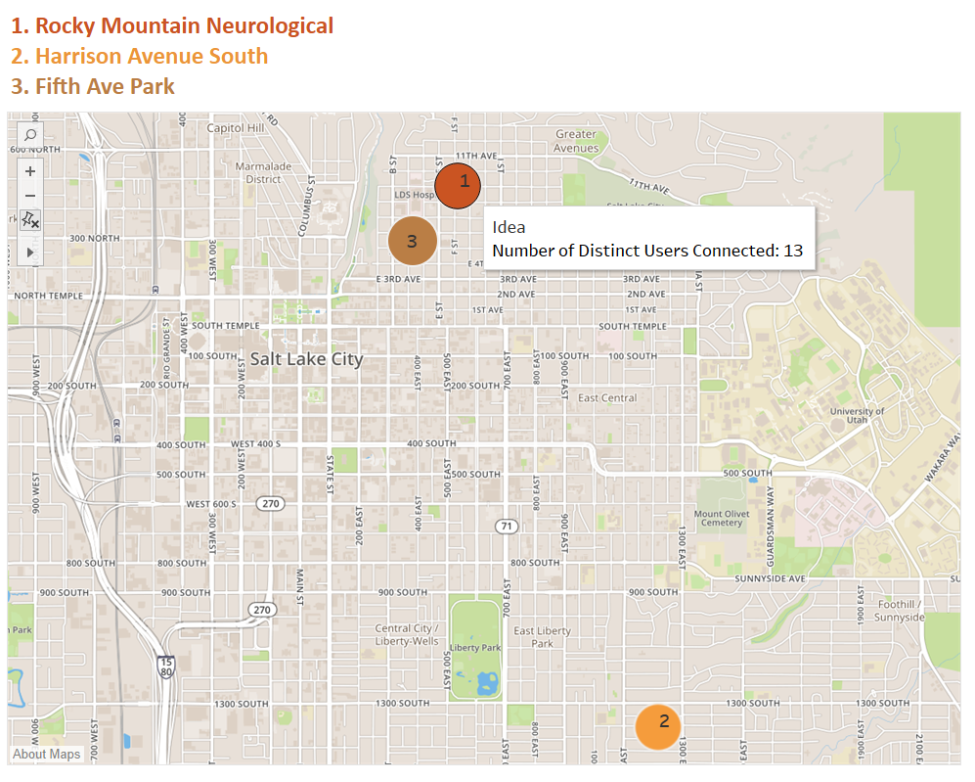
Sites with low network usage for Idea

Slide 21
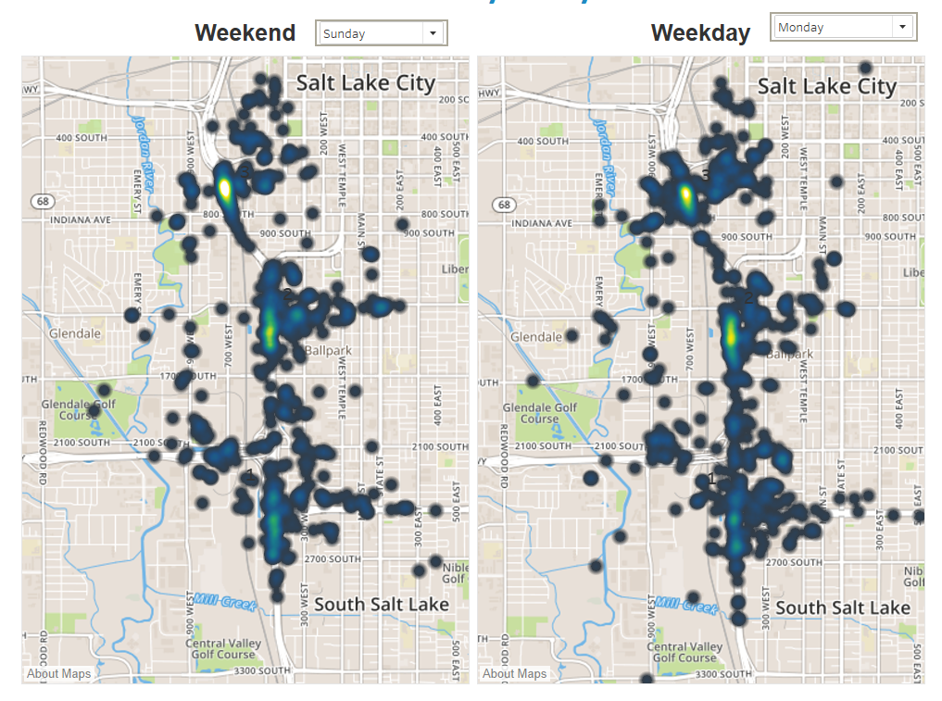
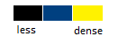
Airtel Network Density in Key Areas of SLC
1. South Salt Lake City (Interpointe Shopping Center, RC Wiley)
2. People's Freeway (Walmart)
3. People's Freeway ( Salt Lake City Crossfit, areas near E Veterans Memorial Hwy)

Slide 22
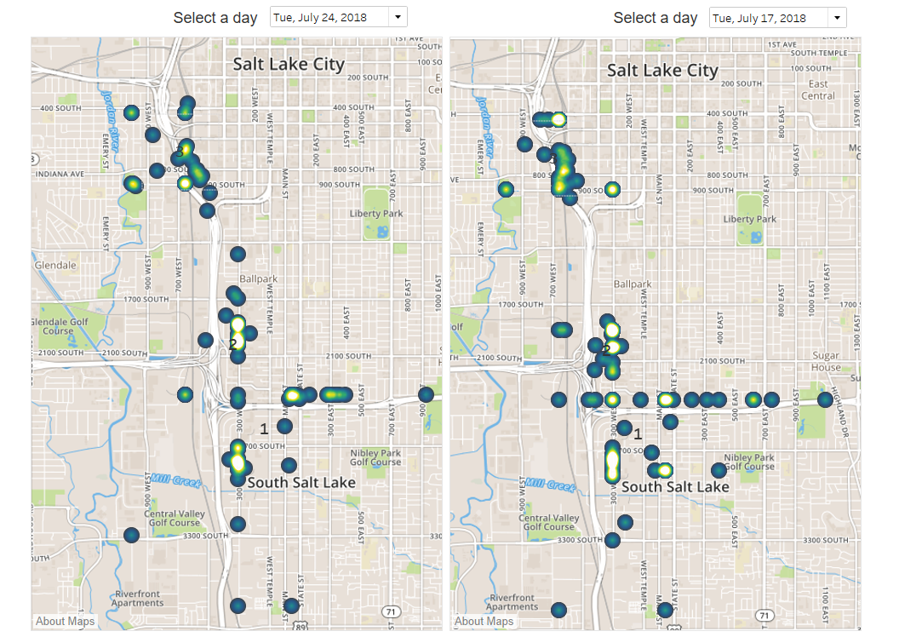
Vodafone Top Sites Network Density- Daywise
Pioneer day vs Normal weekday
1. South Salt Lake (Oakland Place)
2. People's Freeway (Costco Wholesale)
3. People's freeway (300 West Town Center, Target)

Slide 23
CHALLENGES
Understanding the client requirements
Understanding the data & domain
Interfacing S3 with Databricks
Integrating Athena with Tableau
Computational expenses - Limiting our AWS usage
Lack of historical data to draw insights

Slide 24

QUESTIONS?

Slide 25
THANK YOU!

